Slide 1

Introduction to ECLIPSE 100

Slide 2
Home
Contents
General Informations »
What is it ECLIPSE 100?
How to start?
Input data file
Section-header Keywords
Keywords in Sections
Useful Informations
Running Simulation
Sample Simulation
GRAF
Excel
GLview
Visualization Software »

Slide 3
General Informations
What is it ECLIPSE 100?
ECLIPSE 100 is a fully-implicit, three phase, three dimensional, general purpose black oil simulator with gas condensate option.
Program is written in FORTRAN77 and operate on any computer with an ANSI-standard FORTRAN77 compiler and with sufficient memory.
ECLIPSE 100 can be used to simulate 1, 2 or 3 phase systems. Two phase options (oil/water, oil/gas, gas/water) are solved as two component systems saving both computer storage and computer time. In addition to gas dissolving in oil (variable bubble point pressure or gas/oil ratio), ECLIPSE 100 may also be used to model oil vaporizing in gas (variable dew point pressure or oil/gas ratio).
Both corner-point and conventional block-center geometry options are available in ECLIPSE. Radial and Cartesian block-center options are available in 1, 2 or 3 dimensions. A 3D radial option completes the circle allowing flow to take place across the 0/360 degree interface.

Slide 4
General Informations
How to start?
To run simulation you need an input file with all data
concerning reservoir and process of its exploitation.
Input data for ECLIPSE is prepared in free format using a keyword system. Any standard editor may be used to prepare the input file. Alternatively ECLIPSE Office may be used to prepare data interactively through panels, and submit runs.
The name of input file has to be in the following format: FILENAME.DATA

Slide 5
General Informations
Input data file
An ECLIPSE data input file is split into sections, each of which is introduced by a section-header keyword. A list of all
section-header keywords is given in following, together with a brief description of the contents of each section and examples of keywords using in file code.
Note that all keywords in input file have to be in proper order
The keywords in the input data file (including section-header keywords) are each of up to 8 characters in length and must start in column 1. All characters up to column 8 are significant. Any characters on the same line as a keyword from column 9 onwards will be treated as a comment.
Use @frame command under UNIX system
to read Reference Manual
Read more about basic principles of computer modeling in Reservoir Simulation e-learning modules or on website: http://iptibm3.ipt.ntnu.no/~kleppe/

Slide 6
Section-header keywords
The list of section-header keywords in proper order:
RUNSPEC
GRID
EDIT
PROPS
REGIONS
SOLUTION
SUMMARY
The sections must be specified in the shown order. It may be helpful to use a mnemonic to remember the order (for example RUth GReets EDgar PROPerly at REGgie's SOcial SUMMer SCHool).
SCHEDULE
It is recommended that the body of sections which are not frequently changed be held in separate files which are included in the data using the INCLUDE keyword.
A data record has to be ended with a slash [/]

Slide 7
Section-header keywords
RUNSPEC
Status:
REQUIRED
Title, problem dimensions, switches, phases present, components etc.
GRID
Status:
REQUIRED
The GRID section determines the basic geometry of the simulation grid and various rock properties (porosity, absolute permeability, net-to-gross ratios) in each grid cell. From this information, the program calculates the grid block pore volumes, mid-point depths and inter-block transmissibilities.
Back to list of
section-header keywords

Slide 8
Section-header keywords
EDIT
Status:
OPTIONAL
Modifications to calculated pore volumes, grid block centre depths and transmissibilities.
PROPS
Status:
REQUIRED
Tables of properties of reservoir rock and fluids as functions of fluid pressures, saturations and compositions (density, viscosity, relative permeability, capillary pressure etc.). Contains the equation of state description in compositional runs.
Back to list of
section-header keywords

Slide 9
Section-header keywords
REGIONS
Status:
OPTIONAL
Splits computational grid into regions for calculation of:
- PVT properties (fluid densities and viscosities),
- saturation properties (relative permeabilities and capillary pressures)
- initial conditions, (equilibrium pressures and saturations)
- fluids in place (fluid in place and inter-region flows)
If this section is omitted, all grid blocks are put in region 1.
SOLUTION
Status:
REQUIRED
Specification of initial conditions in reservoir - may be:
- calculated using specified fluid contact depths to give potential equilibrium
- read from a restart file set up by an earlier run
- specified by the user for every grid block (not recommended for general use)
This section contains sufficient data to define the initial state (pressure, saturations, compositions) of every grid block in the reservoir.
Back to list of
section-header keywords

Slide 10
Section-header keywords
SUMMARY
Status:
OPTIONAL
Specification of data to be written to the Summary file after each time step. Necessary if certain types of graphical output (for example water-cut as a function of time) are to be generated after the run has finished. If this section is omitted no Summary files are created.
SCHEDULE
Status:
REQUIRED
Specifies the operations to be simulated (production and injection controls and constraints) and the times at which output reports are required. Vertical flow performance curves and simulator tuning parameters may also be specified in the SCHEDULE section.
Back to list of
section-header keywords

Slide 11
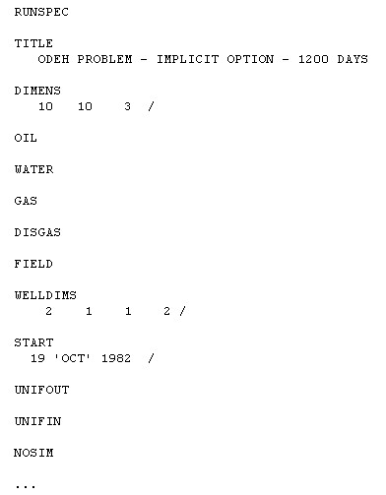
Keywords in sections
RUNSPEC section
TITLE
title
DIMENS
number of blocks in X,Y,Z directions
OIL, WATER, GAS, VAPOIL, DISGAS
the active phases present
FIELD/METRIC/LAB
unit convention
WELLDIMS
well and group dimensions
UNIFIN
indicates that input files are unified
UNIFOUT
indicates that output files are unified
START
start date of the simulation
data checking only, with no simulation
NOSIM
See a part of
input file

Slide 12
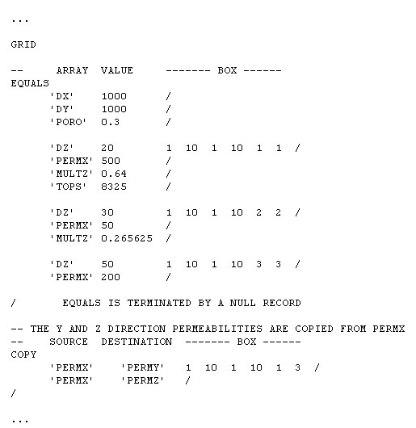
Keywords in sections
GRID section
TOPS
depths of top faces of grid blocks for the current box; data is taken from Structure map, and geological model from IRAP
X,Y,Z-direction grid block sizes for the current box; data is taken from Isopac map, and geological model from IRAP
DX, DY, DZ
PERMX, PERMY, PERMZ
X,Y,Z-direction permeabilities for
the current box; data is taken from
Isopac map, and geological model from IRAP
PORO
grid block porosities for the current box; data is taken from Isopac map,
and geological model from IRAP
See a part of
input file

Slide 13
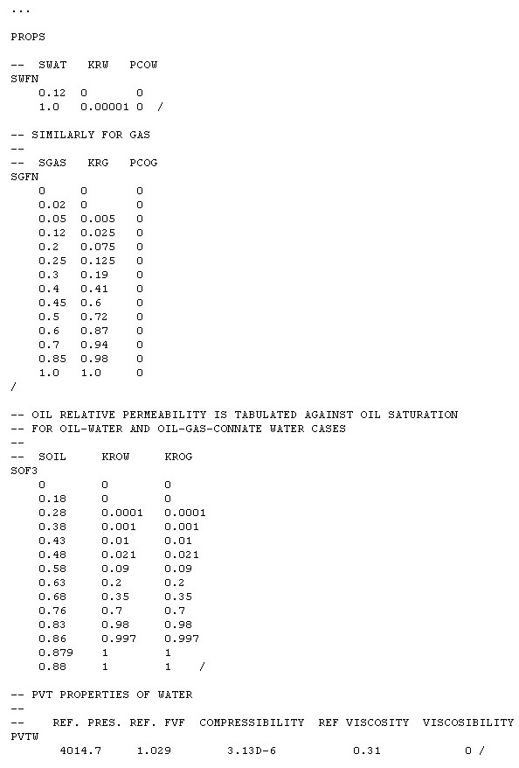
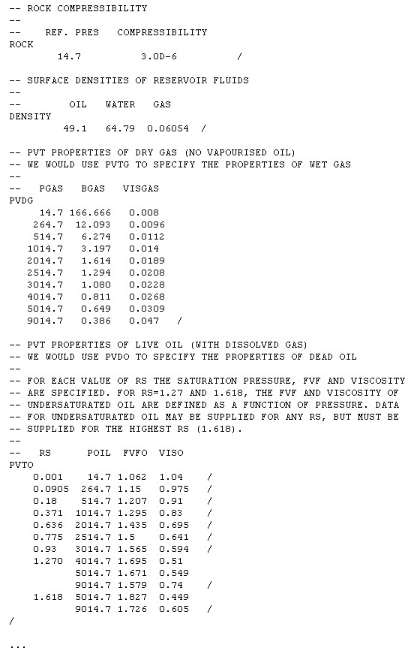
Keywords in sections
PROPS section
SWFN
water relative permeability and capillary pressure as functions of S_{w}
SOF3
oil relative permeability as a function of S_{o}
in three phase system
saturation tables
from special
core analysis
SGFN
gas relative permeability and capillary
pressure as functions of S_{g}
PVTO
FVF and viscosity of live oil as functions of pressure and R_{s}
FVF and viscosity of wet gas as functions of pressure and R_{v}
reservoir fluid
properties from
PVT analysis
PVTG
PVTW
FVF, compressibility and viscosity of water
DENSITY
stock tank fluid densities
ROCK
NEXT
rock compressibility
See a part of
input file
REMOVE

Slide 14
Keywords in sections
REGIONS section
FIPNUM
fluid-in-place regions
SATNUM
saturation table regions
EQLNUM
equilibration regions
PVTNUM
PVT data regions

Slide 15
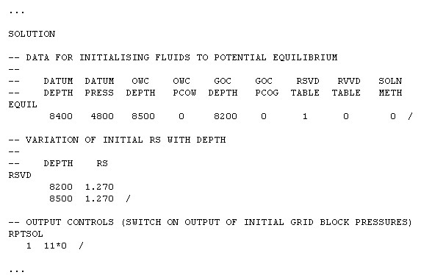
Keywords in sections
SOLUTION section
EQUIL
fluid contact depths and other equilibration parameters;
data taken from well testing
RESTART
name of the restart file
RPTSOL
report switches for SOLUTION data
See a part of
input file

Slide 16
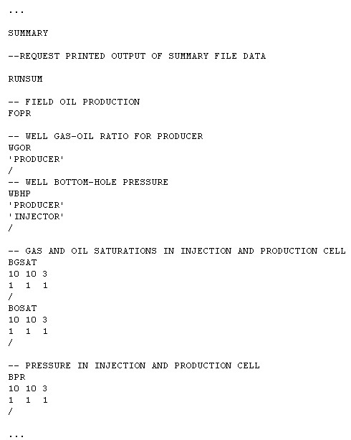
Keywords in sections
SUMMARY section
FOPT
Field Oil Production Total
FOPR
Field Oil Production Rate
FGOR
Field Gas-Oil Ratio
FWIR
Field Water Injection Rate
FOE
Field Oil Efficiency
FPR
Field PRessure
WBHP
Well Bottom Hole Pressure
FWCT
Field Water CuT
WOPR
Well Oil Production Rate
See a part of
input file

Slide 17
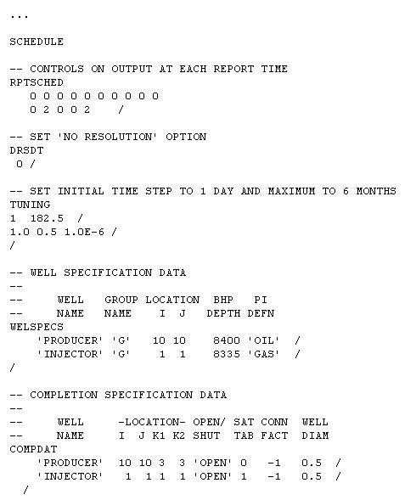
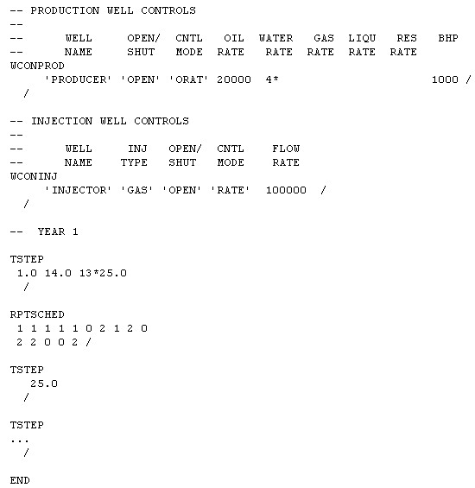
Keywords in sections
SCHEDULE section
RPTSCHED
report switches to select which simulation results are to be printed at report times
TUNING
time step and convergence controls
WELSPECS
introduces a new well, defining its name, the position of the wellhead, its bottom hole reference depth and other specification data
specifies the position and properties of one or more well completions; this must be entered after the WELSPECS
COMDAT
WCONPROD
control data for production wells
NEXT
WCONINJE
control data for injection wells
observed rates for history matching wells
WCONHIST
REMOVE
TSTEP or DATE
advances simulator to new report time(s) or specified report date(s)
See a part of
input file

Slide 18
Useful informations
Repeat counts
In the data following a keyword, asterisks may be used to signify repeat counts. A data quantity can be repeated a required number of times by preceding it with the required number and an asterisk.
There must be no intervening blank spaces next to the asterisk on either side.
For example, the two following cases are equivalent:
RPTSCHED
0 0 0 0 0 0 0 0 0 0
0 2 0 0 2 /
See an example
RPTSCHED
11*0 2 2*0 2 /
Comments
Any lines beginning with the two characters ‘--’ are treated as comments, and will be ignored by ECLIPSE. Comment lines (and blank lines also) may be inserted anywhere in the data file. Comments may also be added to the end of lines of data by beginning the comment with the two characters ‘--’, but in this case the comments must not contain any quotes. Comments can also be included, without the two characters ‘--’, on the same line after a slash (/) which is used to terminate a data record.
-- VARIATION OF INITIAL RS WITH DEPTH
--
-- DEPTH RS
RSVD
8200 1.270
8500 1.270 /
See an example

Slide 19
Useful informations
Default values
Certain items of data can be defaulted to a built-in default value. The keyword description will indicate when defaults can be applied. There are two ways of setting quantities to their default values. Firstly, by ending a data record prematurely with a slash (/) the quantities remaining unspecified will be set to their default values. Secondly, selected quantities positioned before the slash can be defaulted by entering n* where n is the number of consecutive quantities to be defaulted. For example, 3* will cause the next three quantities in the keyword data to be given their default values. There must be no blank space between the number and the asterisk. If there is only one item at a time to be defaulted, then 1* must be entered. An asterisk by itself is not sufficient.
See an example
WCONPROD
'PRODUCER' 'OPEN' 'ORAT' 20000 4* 1000 /
/

Slide 20
Running simulation
Running simulation
When your input file is already prepared, type: @eclipse FILENAME (without suffix) in UNIX.
The simulation will start. While the model is running, status reports will be written to the screen. The same information is also written to the file FILENAME.PRT which is created in your folder. If input file was not prepared properly the simulation would stop and then you can check what was wrong. For this purpose you have to look through FILENAME.PRT file and then try to correct mistakes.
After successful run you will get output files which can be used with visualization software to preset simulation results.

Slide 21
Sample simulation
Sample simulation
In the following we will consider simple case of simulation in purpose to familiarize with visualization software.
Detailed problem description with all needed data and input file for ECLIPSE 100 can be obtain from the following links:
Problem description
odeh.pdf file
Input data file
ODEH.DATA

Slide 22
Sample simulation
Statement of the problem
There will be consider simple model of reservoir consist of 3 layers and 10 grid blocks in X as well as in Y direction. Click on link below to see grid block model used in simulation:
See the grid model
Production will occure under gas drive.
There is no water phase present in ths simulation.
The reservoir is initially undersaturated. We assume that R_{s} cannot rise and free gas does not dissolve in undersaturated oil.
Use of DRSDT keyword
If DRSDT is set to 0, R_{s} cannot rise and free gas does not dissolve in undersaturated oil (no re-solution). At the other extreme, if DRSDT is very large, R_{s} rises very quickly until either the oil is saturated or no free gas remains (total re-solution).

Slide 23
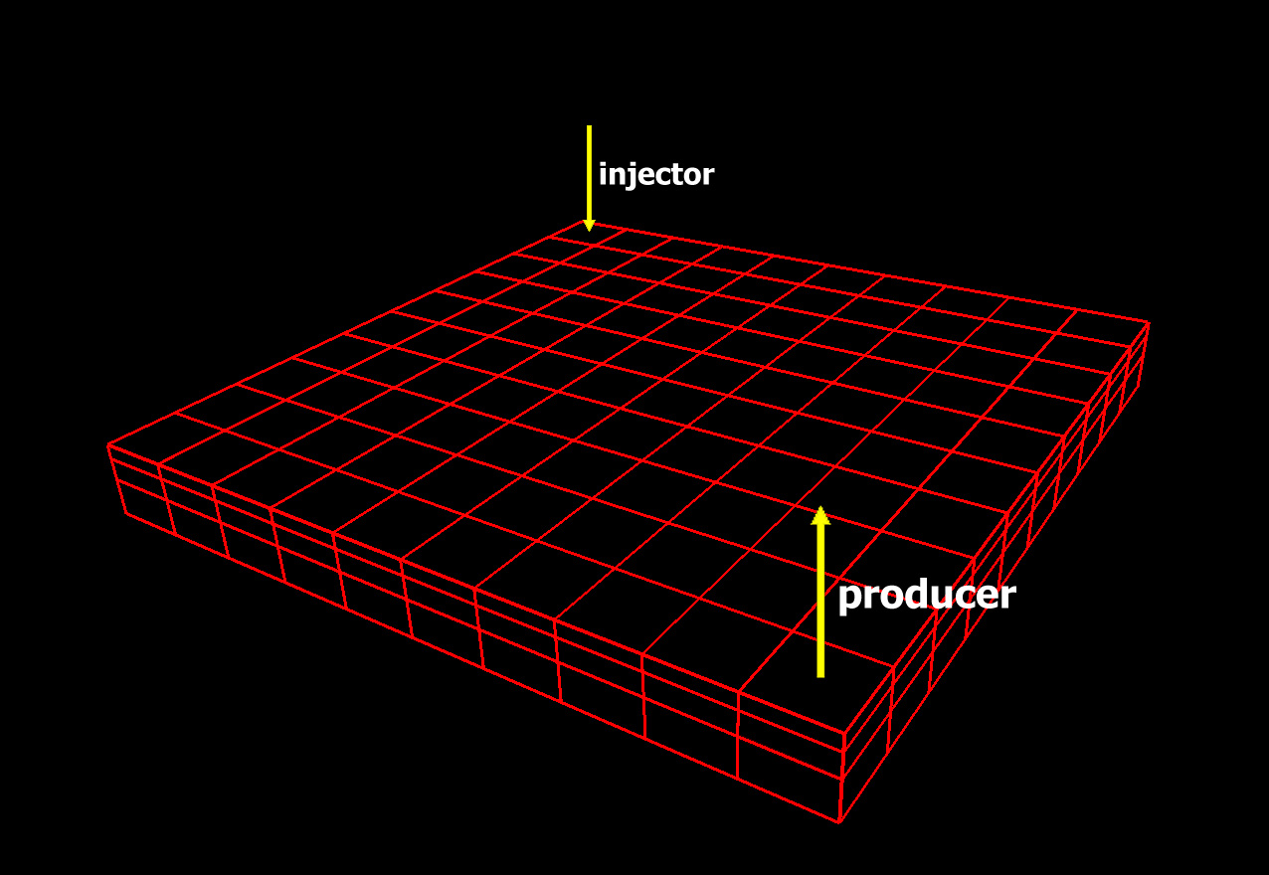
1
1
2
3
X
Y
3
2
4
5
4
6
7
5
8
9
6
10
7
1
8
2
Z
9
3
10
BACK

Slide 24
Sample simulation
Running simulation
Run ECLIPSE 100 simulator with ODEH.DATA file – type in UNIX: @eclipse ODEH
When the run is finished, your folder contains the following files:
ODEH.DBG
ODEH.EGRID
ODEH.PRT
ODEH.INIT
ODEH.SMSPEC
ODEH.UNRST
ODEH.UNSMRY
ODEH.RSSPEC
ODEH.INSPEC
Next step is visualization of obtained results

Slide 25
Visualization software
Visualization software
Visualization of obtained results can be made by using different software. We will present three the most popular programs:
GRAF
Excel
GLview

Slide 26
GRAF
GRAF
Start the GRAF program by typing @graf in UNIX.
Choose following options:
- Do you want to run a GRF in the background (y/N) [default n]?:
n (choose default)
- Please choose type of run: 2 (Interactive, with graphics)
- Please input the required device number: 98 (X-Windows for Weltest200).

Slide 27
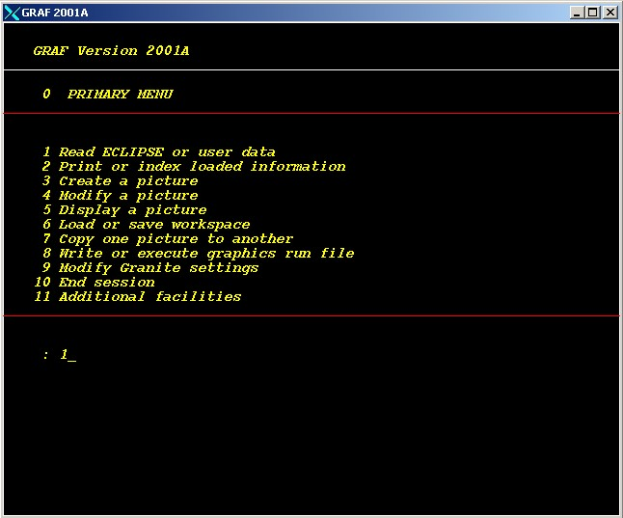
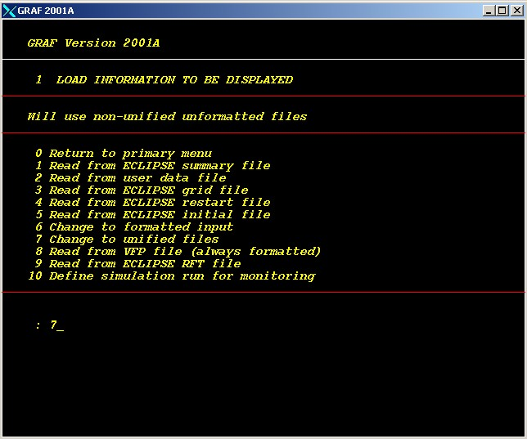
GRAF
At the first menu in GRAF, use option 1.
If in your input data file is used UNIFOUT keyword choose then 7.

Slide 28
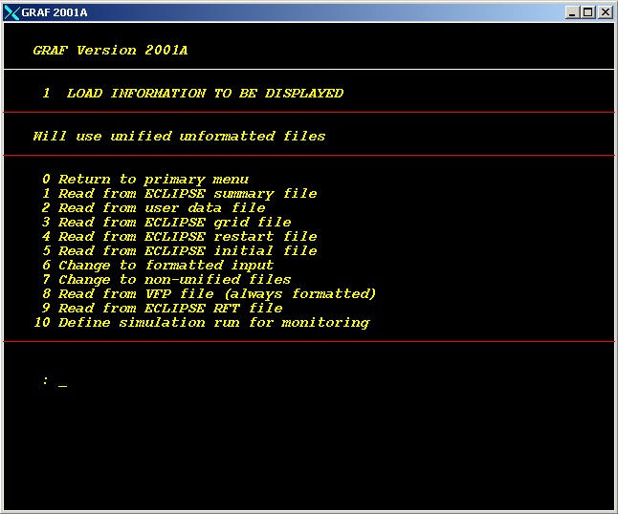
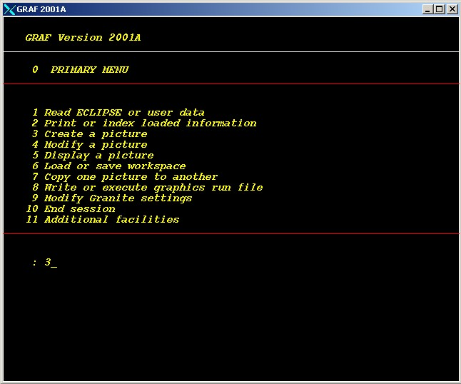
GRAF
Then read options 1, 3, 4, 5 (specify file name, ie. ODEH).
Return to primary menu by 0.
Choose 3 to make plots.

Slide 29
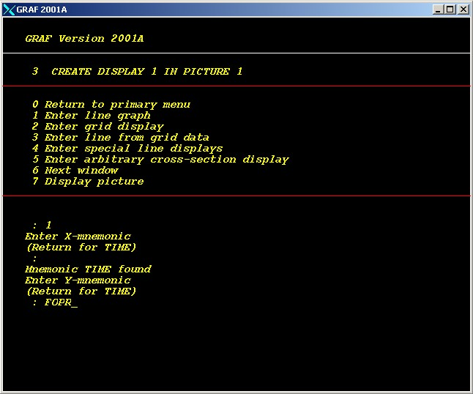
GRAF
Choose 1 and then specify:
X-mnemonic: TIME
Y-mnemonic: ie. FOPR
(Field Oil Production Rate).
Display picture by 7.
You can repeat above procedure for other parameters.
For ODEH simulation
you can make for instance following plots:
WGOR vs. TIME,
WBHP vs. TIME
(specify well: PRODUCER),
WBHP vs. TIME
(specify well: INJECTOR).
X-mnemonic is usually TIME
You can use every Y-mnemonic specified in SUMMARY section of input file

Slide 30
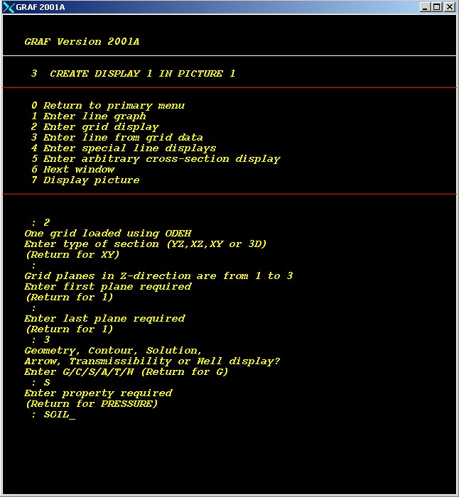
GRAF
If you choose 3 you will be able to make grid plots.
For instance you can make a saturation plots of cross-section.
You will have to specify planes, type of display (Solution – S), required property (ie. SOIL, SGAS, SWAT), and time steps in which you want to see a model of reservoir.
SOIL – saturation of oil
SGAS – saturation of gas
SWAT – saturation of water

Slide 31
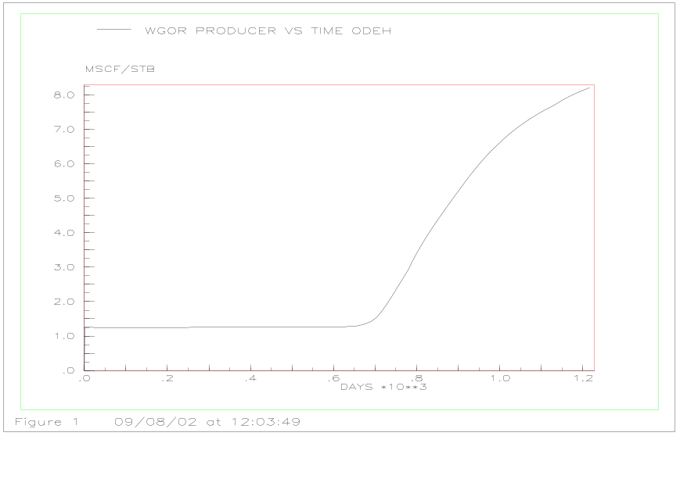
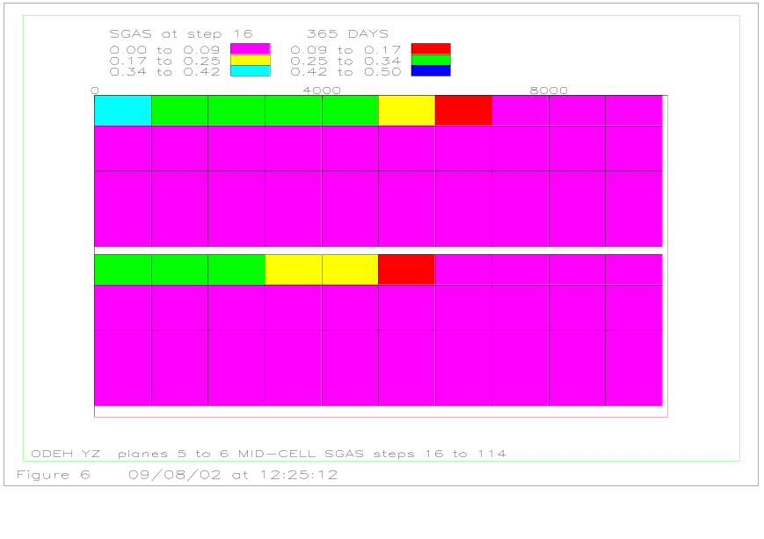
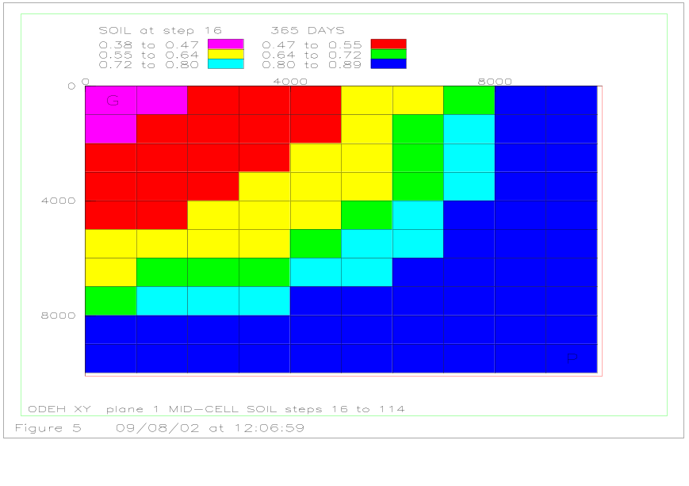
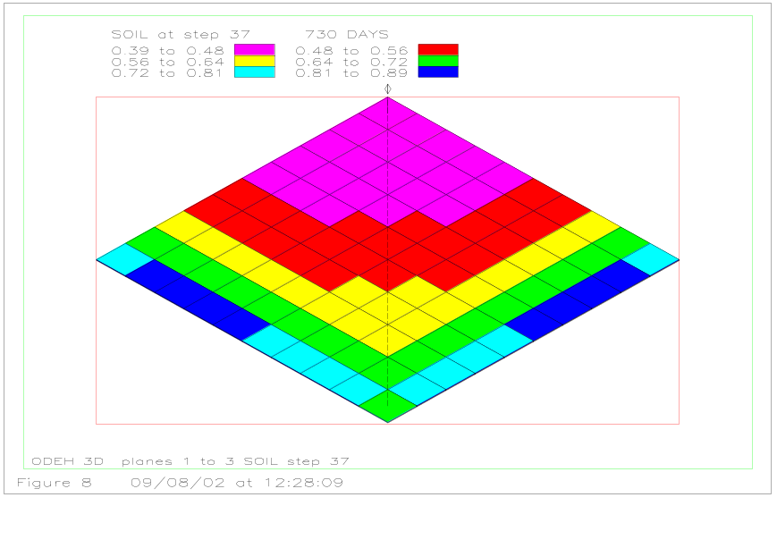
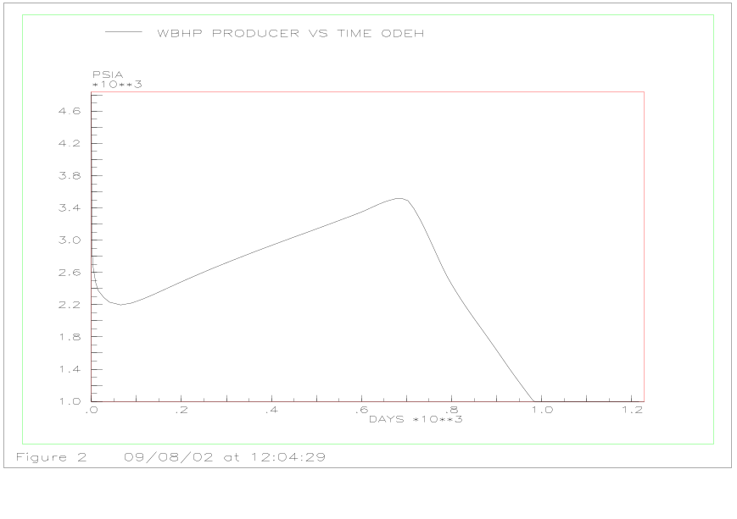
GRAF
These are sample plots made in GRAF:
Next

Slide 32
GRAF
How to print pictures from GRAF?
In the primary menu in GRAF choose 5 (Display a picture).
Choose 4 (Change output device) and type 5 (Landscape) or
6 (Portrait) (you can check the list of available output devices by 5 (Show list of possible output devices)).
Type then 1 (Display picture). A postscript file(s) named POST.N000X will be made (where X is picture number).
Go to the UNIX terminal window and type: lpr POST.N000X
The picture will be printed on the postscript printer.
How to use GRAF pictures with MS Office?
In the primary menu in GRAF choose 5 (Display a picture).
Type 4 (Change output device) and specify 97
(’CGM Metafile’ for Office 97).
Type then 1 (Display picture). File(s) named CGMB.N000X will be created. There will be as many files as pictures made in GRAF.
In order to use pictures, for instance with Word, there must be suffix *.CGM added to the file name.

Slide 33
GRAF
Graphics Run File
You can use Graphics Run File to make using of GRAF more convenient.
When you have done with data read and you made plots go to 8 in primary menu (Write or execute graphics run file), then 1 (Write graphics run file) and then 1 (Write to GRF) and specify file name.
FILENAME.GRF file will be created.
This file may be afterwards edited in text editor (ie. emacs) where you can add new plots, change titles, etc.

Slide 34
Excel
How to use ECLIPSE 100 output data to create plots in Excel?
To be able to make plots in Excel, you have to include in input data file, under SUMMARY section-header keyword, the following keywords:
----------------
SUMMARY
----------------
EXCEL
SEPARATE
After succesful run a file named FILENAME.RSM will be created.
This file can be read by Excel, and data is in separated columns.
Then make plots in Exel as usual.

Slide 35
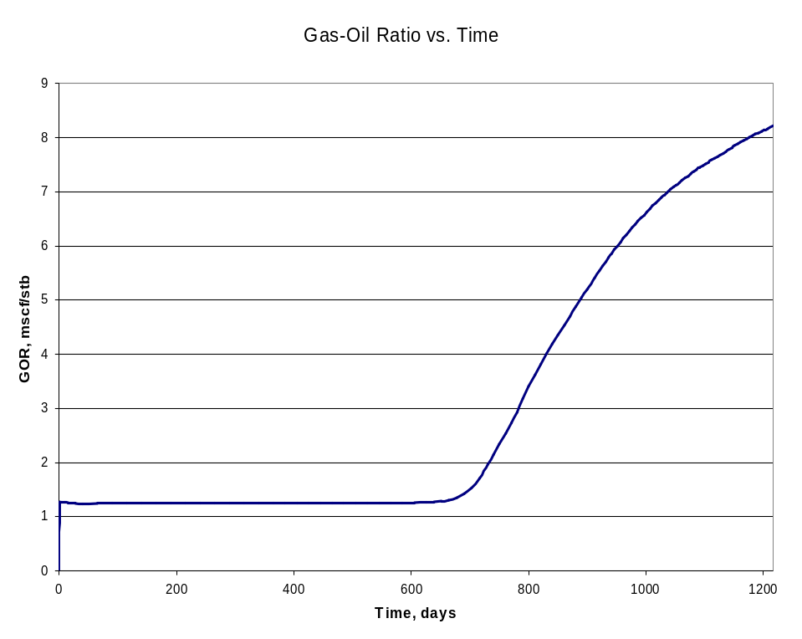
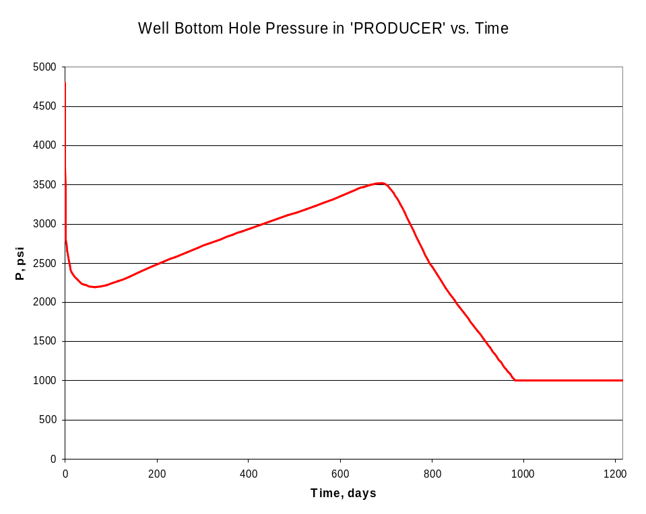
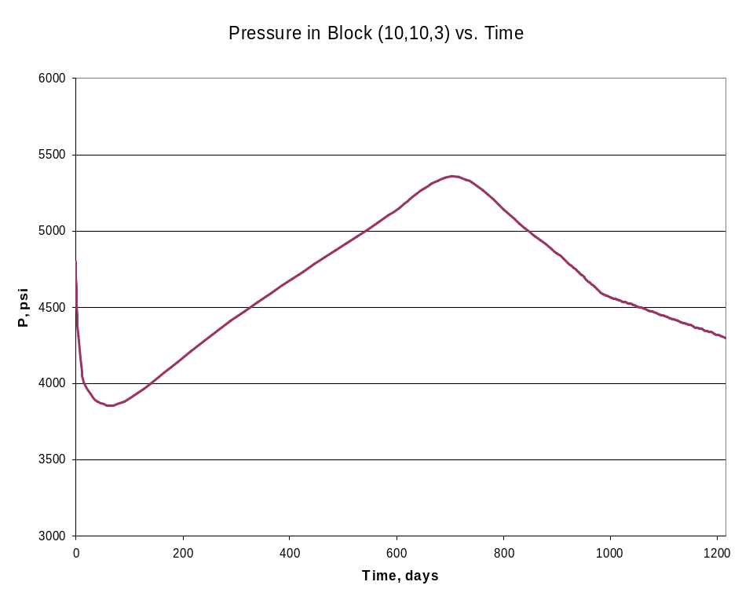
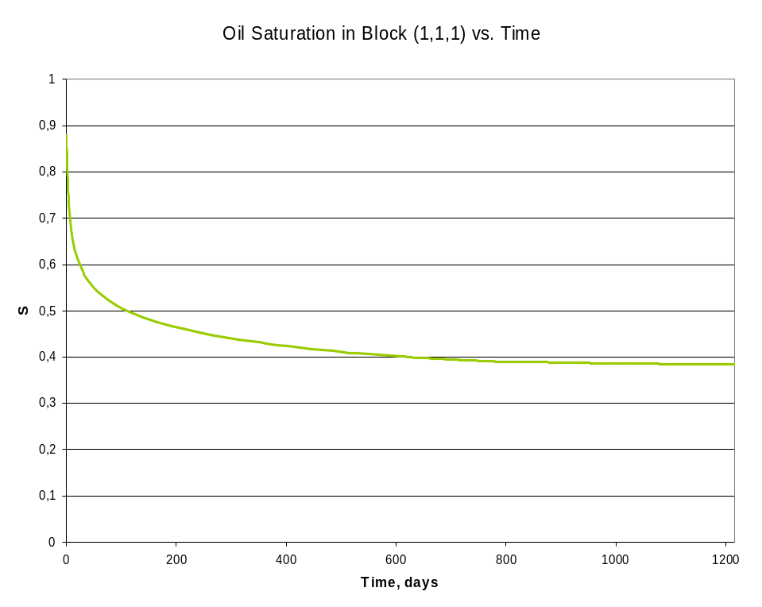
Excel
These are sample plots made in Excel:
Next

Slide 36
GLview
GLview
To use ECLIPSE 100 output data with Ceetron GLview software the FILENAME.VTF file is needed.
It can be made in UNIX, in the same folder where you have run simulation, by typing: @eclvtf FILENAME
The following output files are read:
FILENAME.EGRID
FILENAME.SMSPEC
FILENAME.UNRST
FILENAME.UNSMRY
When FILENAME.VTF file has been already created it can be used with Ceetron GLview software.
Results can be presented as 3D models as well as 2D plots.

Slide 37
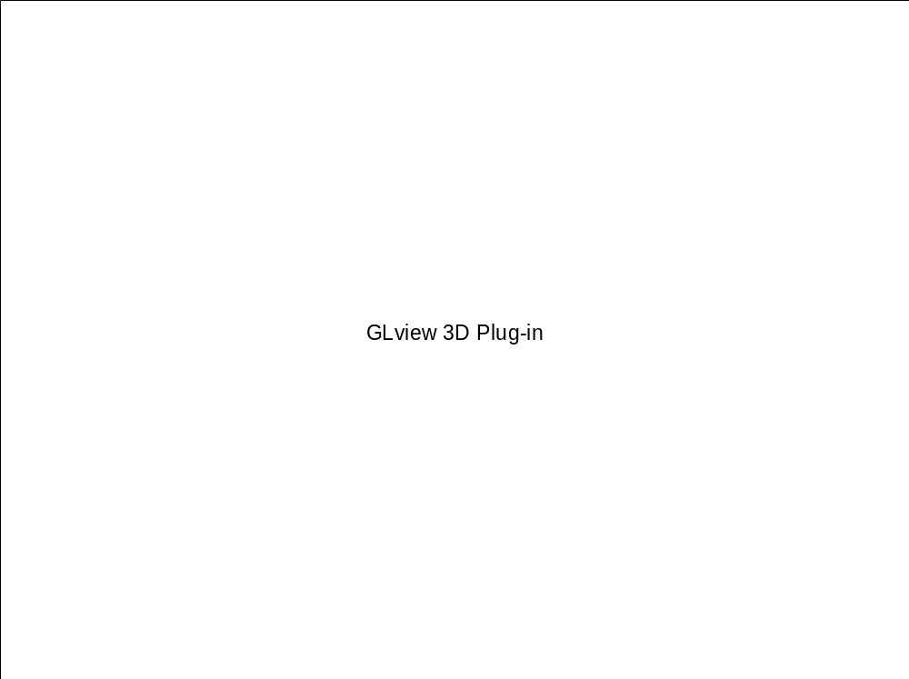
GLview
This is a sample GLview animation (based on ODEH simulation):

Slide 38
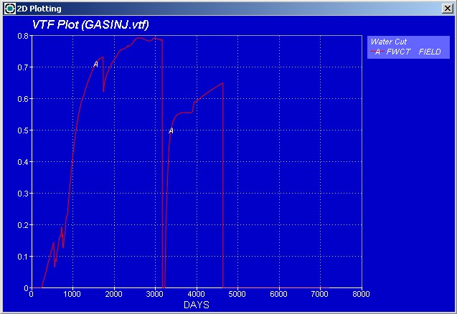
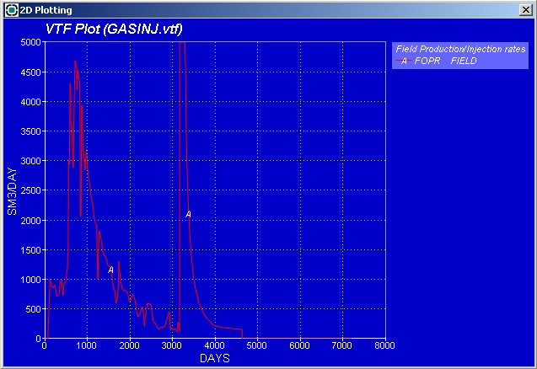
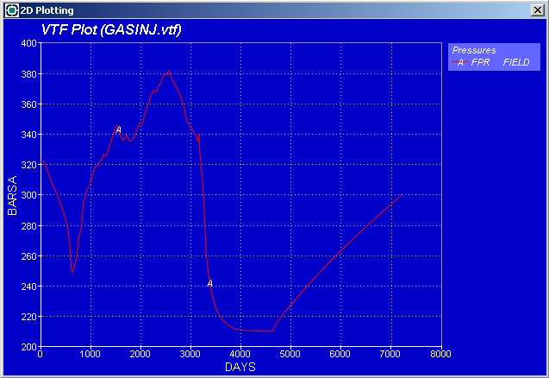
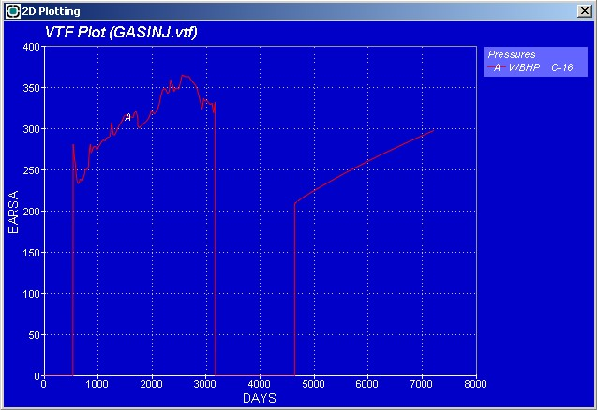
GLview
These are sample plots made in GLview:
Next

Slide 39
General information
Title:
Teacher(s):
Assistant(s): | Szczepan Polak
Abstract:
4 keywords:
Topic discipline:
Level:
Prerequisites:
Learning goals:
Size in megabytes:
Software requirements:
Estimated time to complete:
Copyright information: | The author has copyright to the module
About the author

Slide 40
FAQ

Slide 41
References
ECLIPSE 100 Reference Manual 2001A, Schlumberger, Geoquest
ECLIPSE 100 Technical Description 2001A, Schlumberger, Geoquest

Slide 42
Summary

Slide 43

About the Author
Name
  Xxx
Education
  Xxx
Experience
  Xxx
Awards
  Xxx
Talks
  Xxx (consider including a text document as an object or link to web site)
Publications
  Xxx (consider including a text document as an object or link to web site)
Address:
  Xxx
E-mail:
  Xxx
Phone:
  Xxx
Web:
  xxx

